Slide 1
The Ins and Outs of Indexes
Indexing Basics in SQL Server
Mindy Curnutt
TMW Systems, Director of DB Architecture
SQL Server MVP
Twitter: @sqlgirl

Slide 2
Agenda
Objectives
Foundation
Clustered Indexes
Non Clustered Indexes
Fill Factor and Fragmentation

Slide 3
Objectives
Understand how to create effective and efficient indexes
Clustered Index
Learn what are they and why important?
Non Clustered Indexes
When and how are they used?
What are Included Columns?
Uniqueness
Why you should care
Explain Fill Factor and Fragmentation

Slide 4


Types of Indexes
The Basics
Clustered
Non Clustered
Unique
Getting Fancy (not in this presentation)
Filtered
Full-Text
Spatial
XML

Slide 5
Agenda
Objectives
Foundation
Clustered Indexes
Non Clustered Indexes
Fill Factor and Fragmentation

Slide 6

Regulations
1 Clustered Index per Table
249 Non Clustered (2005)
999 Non Clustered (2008+)
16 Columns or 900 Bytes

Slide 7
Agenda
Objectives
Foundation
Clustered Indexes
Non Clustered Indexes
Fill Factor and Fragmentation

Slide 8
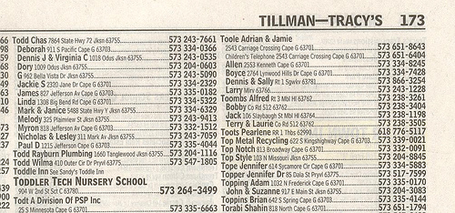
Clustered Indexes
Clustered Index – sort order of the data within the table on the hard drive and in memory.
One per table

Slide 9
Clustered Indexes
Desired Qualities
Narrow Data Type
Unique
Static
Increasing

Slide 10
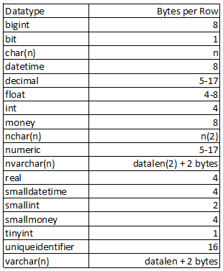
Clustered Indexes
Narrow Data Type
Less Data Duplicated
Smaller…
Databases
Backups
Maintenance Plan Times
Scans

Slide 11

Clustered Indexes
Unique
Not Required
Prevents Uniqueifier
Best to be Narrow…remember?

Slide 12

Clustered Indexes
Static
Changes cause…
Additional overhead for Non Clustered Indexes
Clustered Index Fragmentation
A Bit of Advice?
Bad Idea

Slide 13

Clustered Indexes
Increasing
Data is added to the end of the index
Reduces fragmentation

Slide 14
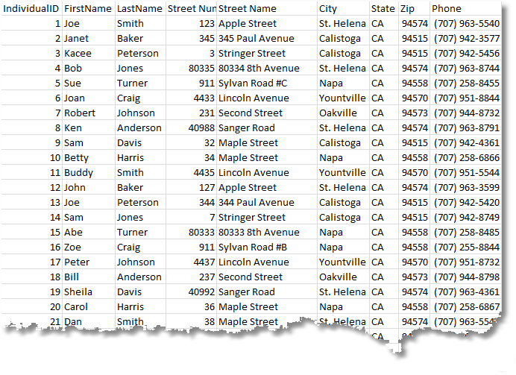
Clustered Indexes

Slide 15
Non Clustered Indexes
Demos
No Clustered Index (Heap)
No Clustered Index (Heap) with Primary Key
Non Unique Clustered Index
Non Unique Clustered Index with Primary Key
Unique Clustered Index
Unique Clustered Index with Primary Key

Slide 16
Agenda
Objectives
Foundation
Clustered Indexes
Non Clustered Indexes
Fill Factor and Fragmentation

Slide 17
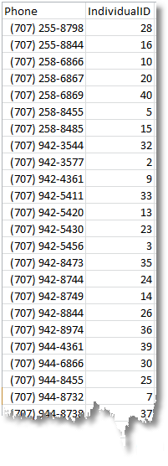
Non Clustered Indexes
Cover Common Queries
Link to Clustered Indexes through Key
Bookmark (Key/RID) Lookup

Slide 18
Non Clustered Indexes
Demo
Bookmark (Key/RID) Lookup

Slide 19
Bookmark (Key/RID) Lookup

Slide 20
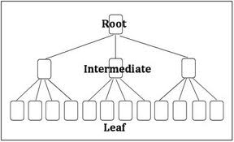
Included Columns
Non Clustered Index Leaf Level Only Information
For Columns in the SELECT statement
Not efficient for filtering, sorting, grouping or joining

Slide 21
Non Clustered Indexes
Demo
Included Columns

Slide 22
Agenda
Objectives
Foundation
Clustered Indexes
Non Clustered Indexes
Fill Factor and Fragmentation

Slide 23
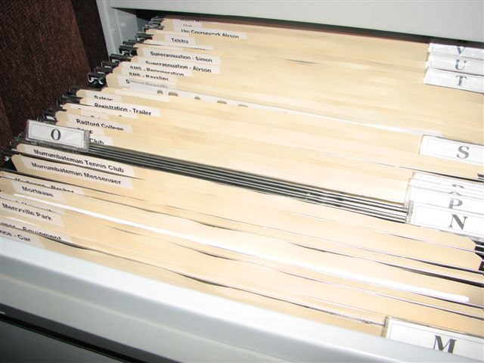
Fill Factor
% of each Extent when indexes are rebuilt
Sequential Indexes – 100%
Non-Sequential Indexes ~ 75-90%
Only applies during index maintenance, not for new records being inserted, updated or deleted

Slide 24

Fragmentation
Fill Factor space used up in extent
Data no longer in “alphabetical” order
Server has to work harder for the same answers

Slide 25
Q U E S T I O N S
Mindy Curnutt Director, Database Architecture, TMW Systems
p: 440.721.2819 e: mcurnutt@tmwsystems.com mindycurnutt@hotmail.com twitter handle: @sqlgirl
M O V I N G Y O U F O R W A R D
T H A N K Y O U

